Slide 1
CSC312
Automata Theory
Lecture # 21
Chapter # 9 by Cohen
Regular Languages

Slide 2
Regular Language:
A language that can be defined by a RE is called a regular language.
Theorem 10:
If L₁ and L₂ are regular languages, then L₁+L₂, L₁.L₂ and L₁* are also regular languages i.e. the set of regular languages are closed under union, concatenation, and Kleene closure.
Proof 1: (by REs)
If L₁ and L₂ are regular language, there are regular expressions r₁ and r₂ that define these languages. Then the languages L₁+L₂, L₁.L₂and L₁* can be defined by the regular expressions r₁+r₂, r₁.r₂ and r₁*. So the above three sets are also regular languages.

Slide 3
Proof 2: (by TGs)
If L₁ and L₂ are regular language, there must be TGs that accept them. Following are the methods showing that there exist TGs corresponding to L₁+L₂, L₁.L₂ and L₁*.
Examples:
Note:
1) If there are more than one initial states, connecting any initial to final is sufficient.
2) Every final state must be connected with initial state.
Exercise Questions 1-15

Slide 4
Complement of a Language:
If L is a language over the alphabet ∑, then its complement L’, is the language of all the strings of letter from ∑ that are not words in L’.
Note: To describe the complement of a language, it is very important to describe the alphabet of that language over which the language is define.
For certain language L, the complement of L’ is the given language L i.e. (L’)’ = L

Slide 5
Compliment of a language Cont.
To take compliment, convert final state to initial state and vice versa. In the same way, make a dead end state the will specify that language is negating the specified rules:
For example, let L1 is accepting set of all strings ending with double letter. L’ will be set of all strings not ending with double letter. Take care of 4 steps: 1) make final state non-final 2) make non-final state to final 3) make initial state to initial and final 4) make final and initial to initial
Courtesy Costas Busch - RPI

Slide 6
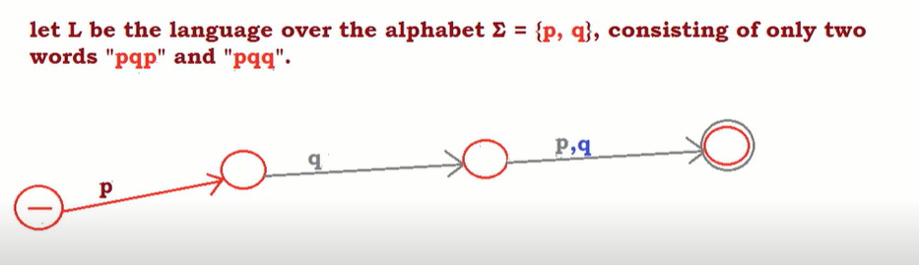
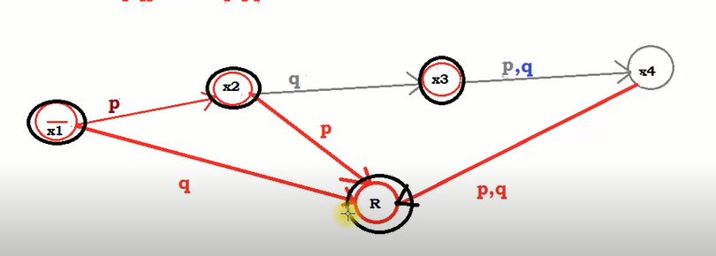
Example:
Compliment:

Slide 7
Theorem 11:
If L is a regular language then L’ is also a regular language. In other words, the set of regular languages is closed under complementation.
Proof:
Since L is a regular language, so by Kleene’s theorem, there exists an FA, say F, accepting the language L. Converting each of the final states of F to non-final states and converting the old non-final states of F to final states we get a new FA that will reject every string belonging to L and will accepts every string, defined over ∑, not belonging to L. Which shows that the new FA accepts the language L’. Hence using Kleene’s theorem L’ can be expressed b some RE. Thus L’ is a regular language.
Example:

Slide 8
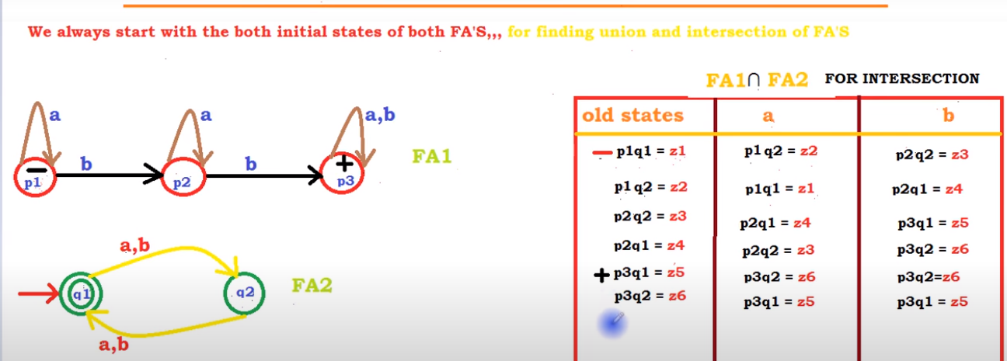
Union & Intersection of FA’s
We need two draw transition table of both FA’s in union and intersection but in case of intersection, we make final state only such state in old state column which contains final state of 1st FA and initial state of 2nd FA.

Slide 9
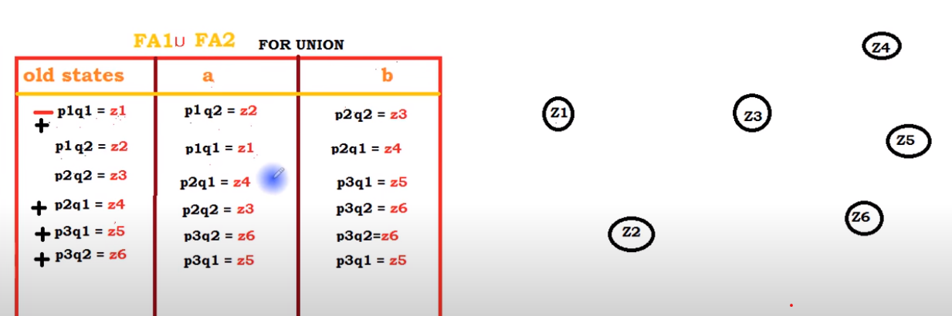
Union & Intersection of FA’s Cont.
In union, we just take concatenation of two FA’s. Now make FA using given states by yourself.
Courtesy Costas Busch - RPI

Slide 10
Closure* of two FA’s:
To take closure of two fa’s, we just need to add two extra transitions in such a way so that it will only accept zero or more occurrences. Of this purpose, first add a empty transition from initial to final state and secondly add a empty transition from final to initial state.
Courtesy Costas Busch - RPI

Slide 11
Closure of two FA’s:
a
b
q1
b
q1
a
q1
^
^

Slide 12
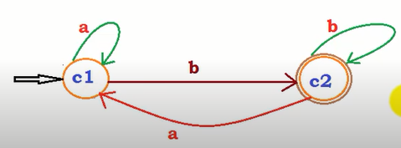
Myhill Nerode theorem:
For a language L, defined over an alphabet Σ, L partitions Σ* into distinct classes. If L generates finite number of classes (states) then it is regular.
Question:
Let the language L of all string, ending with b, defined over Σ={a , b}

Slide 13
Remaining:
It can be observed that L partitions Σ* into the following classes:
C1= set of all strings ending in a.
C2= set of all string ending in b.
Since these are finite classes.. L is regular language.
Courtesy Costas Busch - RPI

Slide 14
Theorem 12:
If L₁ and L₂ are regular language, then L₁ ∩ L₂ is also a regular language. In other words, the set of regular languages is closed under intersection.
Proof:
By De-Morgan’s Law for sets

Slide 15
Prefix & Suffix of Language:
Let L1 and L2 are two language, if we put all the strings of L1 into L2 and if exist at end of L2 then the set remaining part (starting substrings) are prefix of L1 in L2. In the same way, suffix is opposite to this. It is set of all the ending non-matched substrings.
For example,
L1= { aa, abaaabb, bbaaaaa, bbbbbbbbbb}
L2= { b, bbbb, bbbaaa, bbbaaaaa}
Prefix of L1 in L2={bbba,bbbaaa, b}
Courtesy Costas Busch - RPI

Slide 16
Prefix & Suffix of Language Cont.
Prefix of L2 in L1= {abaaab, bbbbbbbbb, bbbbbb}
Suffix of L1 in L2= {null}
Suffix of L2 in L1= {baaaaa, bbbbbbbbb, bbbbbb}
Courtesy Costas Busch - RPI

